Slide 1

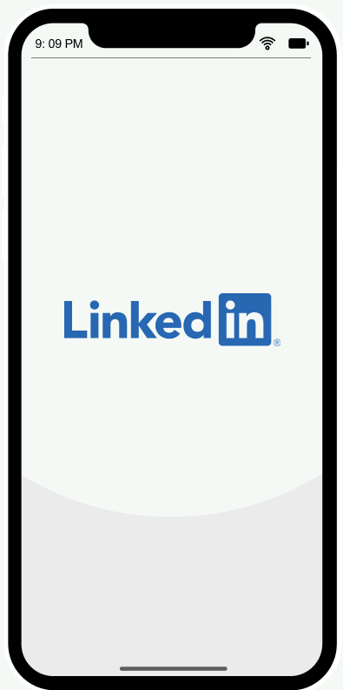
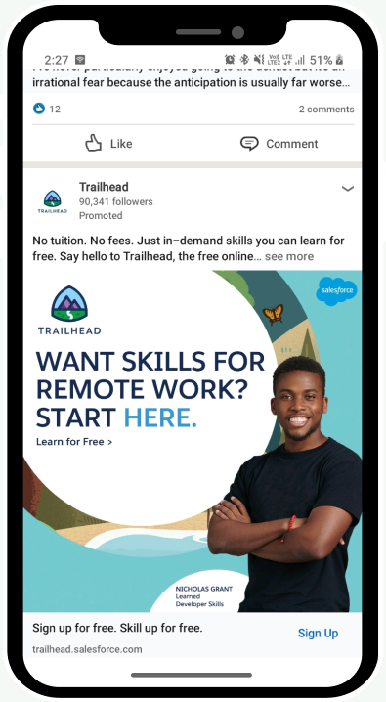
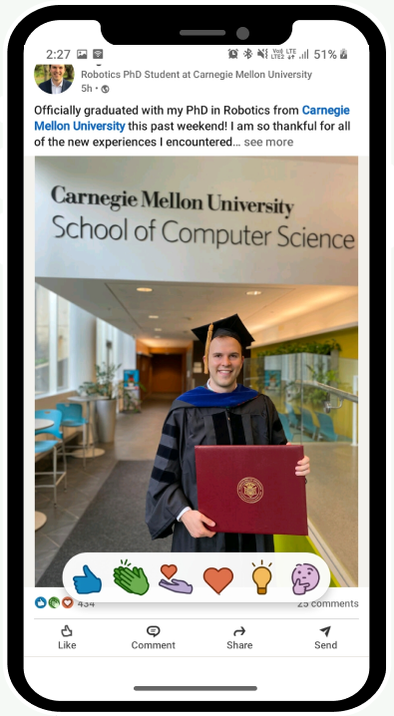




A case study
To improve ‘See All Activity’ feature in LinkedIn app/website
The Problem
User Research
Targeted User Persona
Feature Suggestions
Wireframes
Alsatwar Sravan Kumar
Indian Institute of Technology (ISM) Dhanbad

Slide 2
ABOUT
LinkedIn is world’s largest professional networking platform with 756 million registered members , and allows job seekers to post their CVs and employers to post jobs. It is envisioning to create economic opportunity for every member of the global workforce
THE PROBLEM
Sravan is a prefinal year student at IIT(ISM) Dhanbad, he is currently looking for summer internship in the field of product management. He uses LinkedIn to find internship opportunities in job section, posts by HRs or startup founders and to gain knowledge ( other people’s experience, thoughts on current scenario and future scope ). He has converted from daily active user to power user of LinkedIn since past two months(As of 25th May 2021). But he faces poor user experience regarding ‘See All Activity’ feature, because
Whenever he visits ‘All activity’ page to see his previously seen post he has to scroll down through the page to find the post
Sometimes he doesn’t find that post
He thinks that this feature has to revamped and redesigned to improve user experience
GOALS
Redesign ‘See All Activity’ page to improve user experience and customer satisfaction
Increase engagement in ‘See All Activity’ page
Increase frequency of visits to ‘See All activity’ page

Slide 3
USER RESEARCH
A survey has been conducted to identify the problem more clearly and in response received 79 answers. The targeted users used for this research are daily active users of LinkedIn( identified as DAU’s of LinkedIn looking at my home feed; messaged every individual I have seen on home feed)
Why User Research ?
The problem has been identified by only a single person(me), so to identify which segment of people are facing this issue, a survey has been conducted.
Hypothesis
1. LinkedIn’s most active and engaging users consider ‘See All Activity’ feature ? If yes, how satisfied they are with this feature ? Do they seek improvisation of user experience?
Users using ‘See All Activity’ page to find previously reacted or commented post, are they satisfied with that experience or not? Or do they seek improvisation of user experience?
3. Students/working professionals ( active LinkedIn users ) looking for job opportunities/sharing opinions, knowledge or success stories/gaining knowledge,
Do they use ‘See All activity’ feature or not ? If they use it, how satisfied they are with this feature ?
Do they seek improvisation of user experience ?

Slide 4
ANALYSIS
Analysis of hypothesis 1
Analyzing LinkedIn’s most active and engaging users who
Scroll more than 5 posts in their feed
Visit more than 5 times per day
More than 10 minutes per day
Looked at rating given by a user of ‘See All Activity’ feature and asked ‘Do they recommend this feature if it is redesigned, and improves user experience’.
The metric used is ‘Net promoter Score (NPS) for the measure of customer loyalty =
( % of promoters (9-10) - % of detractors(1-6) )
NPS of current ‘SAA’ design = 0
NPS if ‘SAA’ design is improved = 37 (since NPS is >20, redesign is required)
NPS metric shows that current design has equal amount detractors and promoters but when ‘SAA’ feature is redesigned, which can ultimately improve user experience, NPS would be increased by 37
This concludes that LinkedIn’s most active and engaging users seek improvisation in ‘See All Activity’ page for better user experience

Slide 5
Analysis of hypothesis 2
Analyzing LinkedIn users who responded ‘yes’ or ‘sometimes’ to question
‘If you go to 'See all activity' in your profile page to revisit the post, do you find your required post in your activity section?’
Neglected users responding ‘No’, since they are already unhappy with this feature, but included other users to know whether feature has to be redesigned to improve user experience or not ?
The metric used is ‘Net promoter Score (NPS) for the measure of customer loyalty =
( % of promoters (9-10) - % of detractors(1-6) )
NPS of current ‘SAA’ page = - 3.57
NPS if ‘SAA’ design is improved = 28.57 (since NPS is >20, redesign is required)
NPS metric shows that current design has more number of detractors than promoters but when ‘SAA’ feature is redesigned, which can ultimately improve user experience, NPS would be increased by 32.14
This concludes that users visiting ‘See All Activity’ page to find previously reacted or commented post are also unsatisfied with this feature seek improvisation for better user experience

Slide 6
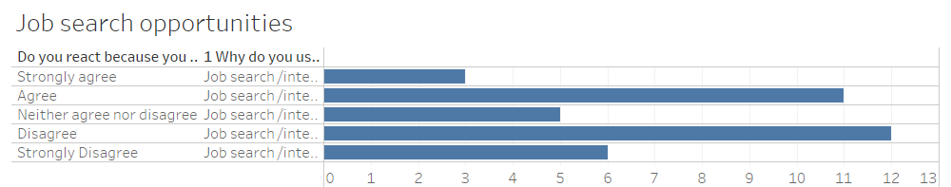
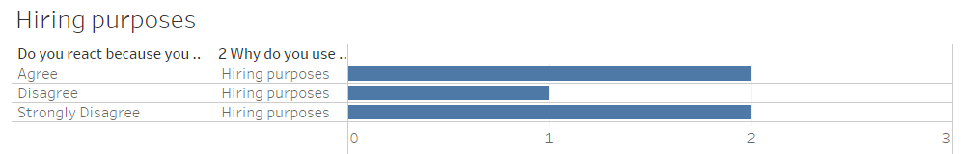
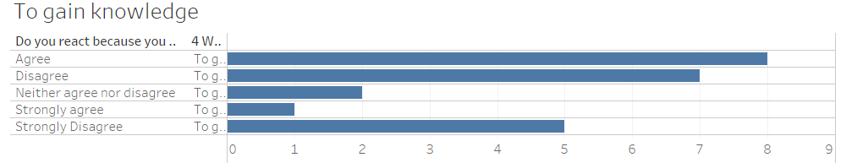
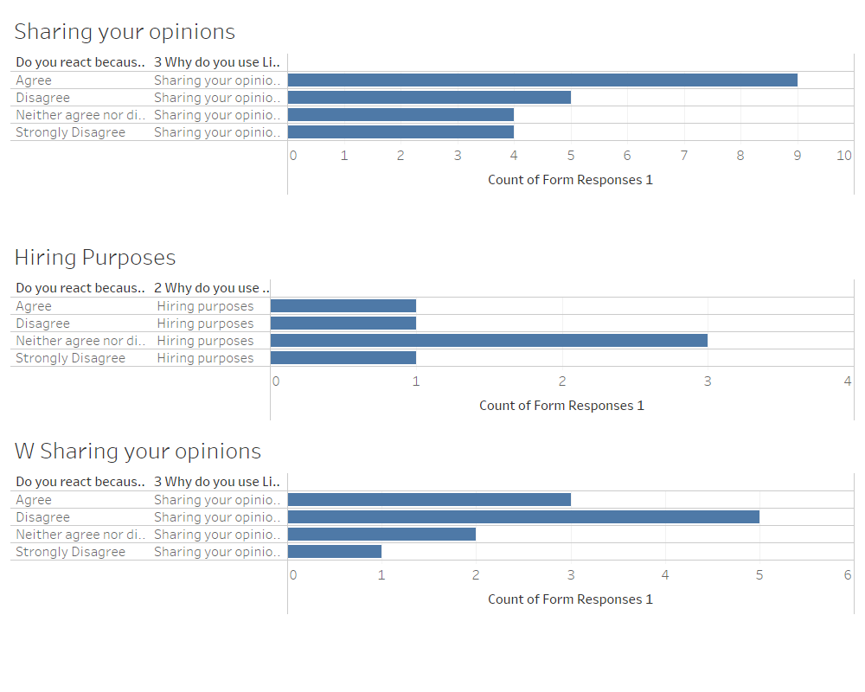
Analysis of hypothesis 3
Analyzing students and working professionals using LinkedIn for various purposes (for job search/internship opportunities, sharing opinions, hiring purposes, gain knowledge, etc.) how do they consider ‘See All activity’ feature and do they use it for revisiting posts reacted or commented
The respondents are asked ‘You react because you want to go back to 'See all activity' and revisit the post thinking that this may be helpful in future? ’
Looking at the results(avg. NPS - -6, for students ), students using LinkedIn for different purposes have different opinions on ‘See All Activity’ feature, which implies LinkedIn has to do some serious work on this feature
Availing points on agree and disagree statement;
Strongly Agree = 2
Agree = 1
Neither Agree nor Disagree = 0
Disagree = -1
Strongly Disagree = -2
The metric used is ‘Net promoter Score (NPS) for the measure of customer loyalty =
Sum of (Number of users in a category)*(availed points in a category)

Slide 7
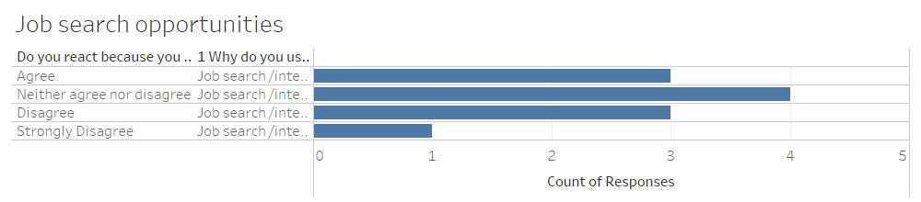
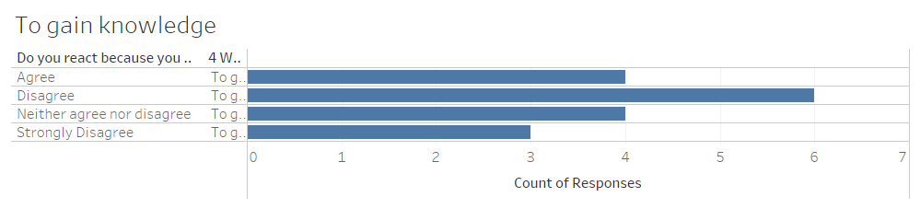
Looking at the results(avg. NPS - -3.5, for working professionals ), working professionals using LinkedIn for different purposes have different opinions on ‘See All Activity’ feature, which implies LinkedIn has to do some serious work on this feature
This analysis concludes that LinkedIn’s targeted customers are unable to use ‘See All activity’ feature efficiently, as LinkedIn built this feature to let users revisit ‘SAA’ page to find reacted, commented, shared and personally posted posts.

Slide 8


TARGETED USER PERSONAS
Alsatwar Sravan Kumar
Nishant Singhal
Student | IIT(ISM) Dhanbad
Product Analyst @ InVideo
Currently completed prefinal year and looking for summer internships in product management
Opens LinkedIn app every one or two hours to find summer intern opportunities
He goes through his home feed to gain knowledge or get interview tips or important resources of aspiring PMs
He actually reacts to every post, but reacts with particular emoji like insightful if he finds informative, loved if any experience shared is sweet, etc.
But when he seek to revisit the post, he has to scroll down the page finding phrase ‘finds this insightful’ or ‘loves this’ or ‘supports this’
Previously worked as Product Analyst at Gojek
Uses LinkedIn daily for an hour
Uses it for hiring new candidates to join his product team, sharing his opinions / knowledge, success stories and gain knowledge
Finds few posts very informative, resourceful and content of curious topics, so he saves the post to save it for future and see it which might be helpful for him

Slide 9
USER JOURNEY
FINDING A POST FROM ‘SEE ALL ACTIVITY’ PAGE
Opens LinkedIn app ( Session starts )
Home page
Finding previous post ?
Visits his profile page
Goes to ‘All Activity’ page
Scrolls down the page to find the post
Regular session?
Scrolls through home page
Reacts to posts
Closes LinkedIn app ( Session ends )
SAVING A POST TO SEE IT IN NEAR FUTURE
Opens LinkedIn app ( Session starts )
Home page
Finding previous post ?
Visits his profile page
Clicks ‘My Items’
Taps ‘Saved Posts’
Regular session?
Scrolls through home page
Scrolls down the page to find the post
Reacts to posts
Taps top right icon and clicks ‘save’ button
Saves the post
Closes the LinkedIn app ( Session ends )

Slide 10
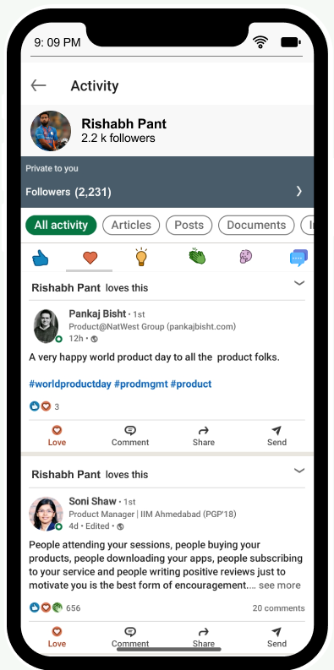
FEATURE SUGGESTIONS
GOALS :
To decrease time consumed by user to find a post on ‘See All Activity’ page
To reduce the size of scrolling page
Create an alternate method to reduce the user journey of saving and finding a post
Segmenting previous activities according to reactions would help users reduce size of scrolling page, reduce time taken to find previous reacted or commented post
Success Metrics :
Incoming traffic from other pages on ‘All Activity’ page
Time gap between two clicks on ‘All Activity’ page
Ratio of (Session time on ‘All Activity’ page, number of clicks during that session)
IMPLEMENTATION :
Add buttons on the top of the page segmenting posts that are Liked, Loved, Celebrated, Insightful, Curious of ‘See All Activity’ page
This would be helpful in reducing size of scrolling page and time consumed

Slide 11
IMPROVED USER JOURNEY
FINDING A POST FROM ‘SEE ALL ACTIVITY’ PAGE
SAVING A POST TO SEE IT IN NEAR FUTURE
Opens LinkedIn app ( Session starts )
Opens LinkedIn app ( Session starts )
Regular session?
Home page
Finding previous post ?
Home page
Finding previous post ?
Scrolls through home page
Visits his profile page
Visits his profile page
Goes to ‘All Activity’
Clicks ‘My Items’
Goes to ‘All Activity’ page
Reacts to posts
Taps on ’insightful’ or ‘curious’ button
Reacts ‘Insightful’ for resourceful or important posts or curious for interesting posts
Taps ‘Saved Posts’
Selects the button according to previous activity
Taps top right icon and clicks ‘save’ button
Scrolls down the page (similar to ‘Saved posts’ page) to find the post
Scrolls down the page to find the post
Taps ‘Like’ icon
Taps ‘Love’ icon
Saves the post
Taps ‘Insightful’ icon
Segmentation decreases time taken to find post and improves user experience
Closes the LinkedIn app ( Session ends )
Taps ‘Celebrate’ icon
Taps ‘Curious’ icon
Taps ‘Comment’ icon
These changes in user journey enhances user experience by reducing size of scrolling page
Scrolls down the page to find the post

Slide 12
THANK YOU!
Alsatwar Sravan Kumar
alsatwarsravan@gmail.com
+91 6303185155

